Slide 1
Statistics and Reliability: Module 1
Statistica
Notes:
Module Objectives:
Use graphical, statistical, and qualitative tools to analyze process feedback.
Use Statistica for data manipulation and analysis.
Topics: Statistica Data Management
Structure of Statistica 7
Output
Data Files
Importing Data
Exporting Data
Options
Copyright (c) Deere & Company, as an unpublished work. This material is the property of Deere & Company. All use, disclosure, and/or reproduction not specifically authorized by Deere & Company is prohibited.

Slide 2
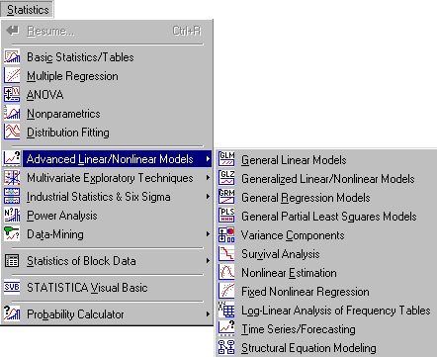
Notes:
Structure of Statistica 7
STATISTICA consists of modules, each containing a group of related statistical procedures. Use the Statistics menu to select the various analyses available in your particular version of STATISTICA.
You can have several copies of STATISTICA open at the same time. Each of them can run similar or different types of analyses. Moreover, in one STATISTICA application, multiple analyses can be open simultaneously. They can be of the same or a different type (e.g., three Multiple Regressions and two ANOVAs), and each of them can be performed on the same or a different input data file (multiple input data files can be open simultaneously).
All “general-purpose” facilities (such as the data spreadsheet, general graphing procedures, and automation facilities) are available in every module and at every point of the analysis.

Slide 3
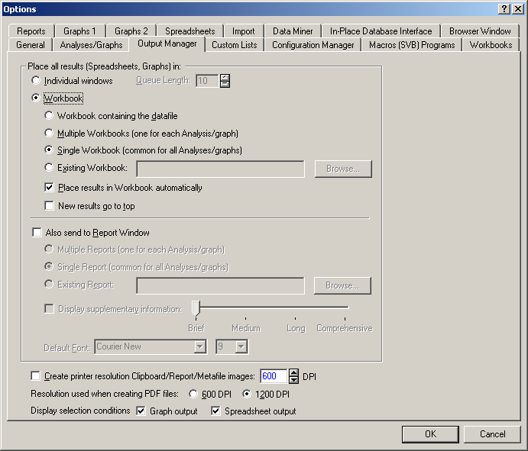
Notes:
Output: Workbooks, Reports, Stand-alone windows
There are three basic channels to which you can direct all output: workbooks, reports, and stand-alone windows. One can adjust the program to display output in the form of their choice by selecting Options from the Tools menu, and clicking on the Output Manager tab.
Personally, I just use the Workbook option and copy and paste output to PowerPoint to share with others.

Slide 4
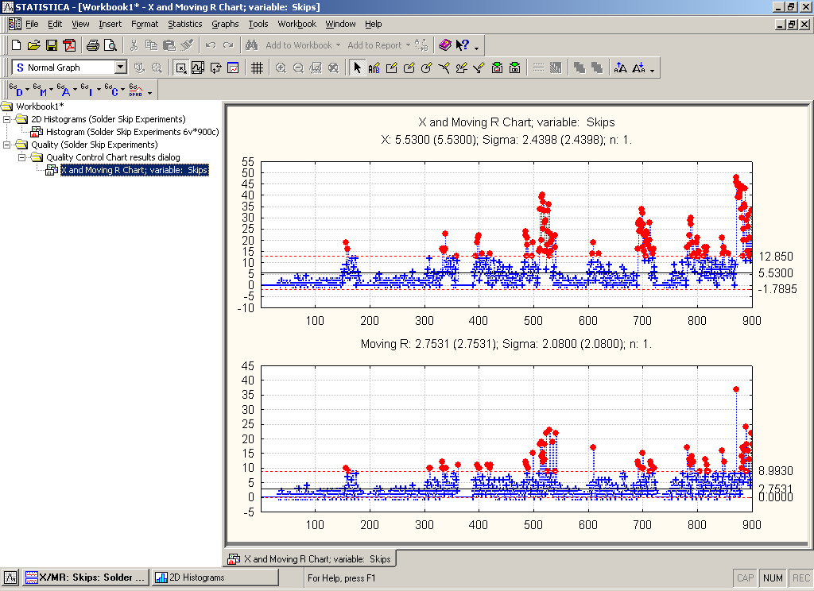
Notes:
Workbooks are the default way of managing output. Each output document is stored as a tab in the workbook. Documents can be organized into hierarchies of folders and documents using a tree view where individual documents and folders or entire branches of the tree can be flexibly managed.
For example, selections of documents can be extracted (drag-copied or drag-moved) to the report window or to the application where they will be displayed in stand-alone windows. Even entire branches can be placed into other workbooks to build a specific folder organization.

Slide 5
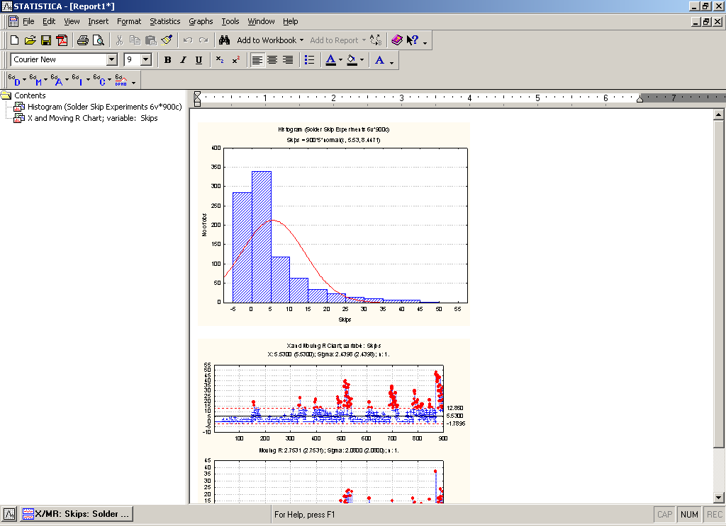
Notes:
Reports in STATISTICA offer a more traditional way of handling output, where each object is displayed sequentially in a word processor style document. The advantages of this format are the ability to insert notes and comments as well as its support for the more traditional way of scrolling through and reviewing the output.
The report output includes and preserves a record of the supplementary information, which contains a detailed log of the options specified for the analyses.

Slide 6
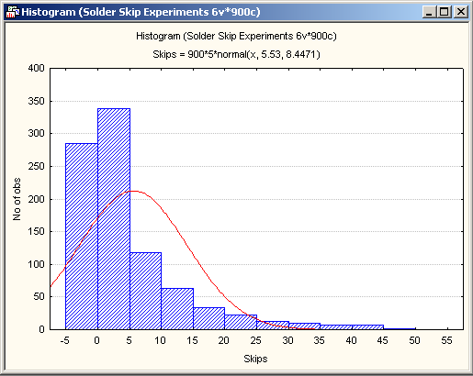
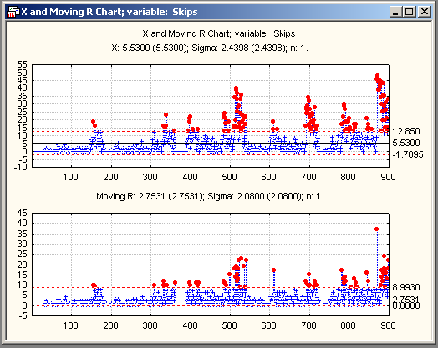
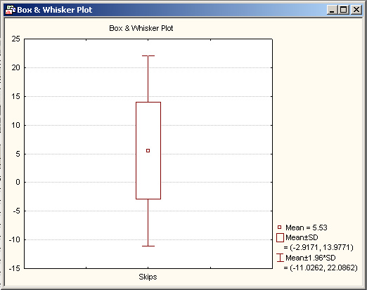
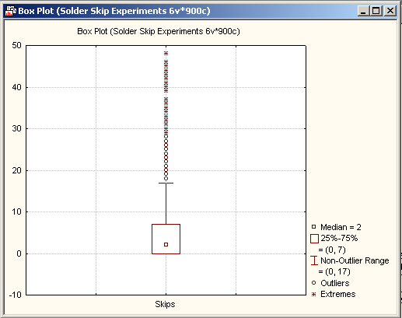
Notes:
Stand-alone Windows
Finally, STATISTICA output documents can also be directed to a queue of stand-alone windows that can be easily custom arranged within the STATISTICA application workspace. This is useful for creating reference documents to compare to new output.

Slide 7
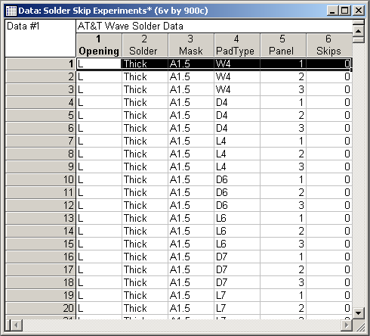
File Header
Title Bar
6 Variables and 900 Cases in File
Variable # 6
Info Box
Case # 1
Notes:
Data Files
The name of the data file is displayed in the title bar, along with the number of variables and cases in the file. Below, the data file title is Solder Skip Experiments, and it contains 6 variables and 900 cases.
Immediately below the title bar is the one-line file header, an optional short description of the data file. Double-click on the header to type in the field.
Additional information about the data can be entered in the Info Box in the upper-left corner of the data file. The Info Box can be accessed by double-clicking in the box. In the data file above, the Info Box contains the description “Data # 1”.
STATISTICA data files are organized into variables and cases. The columns are the variables (equivalent to fields in data base programs), and the rows, or observations, are the cases (equivalent to records in data base programs).
The variable names are listed across the top of the data file, and the case names, optionally, are displayed down the left side of the data file. In the data file above, the last variable’s name is “Skips” and the first case’s name is “1”.

Slide 8
Variables
Cases
Notes:
Variable And Case Specifications
Variables and cases can be modified in several ways: add variables, move cases, recalculate variables, etc. Most options for modifying variables and cases can be accessed from the Vars and Cases toolbar button menus.

Slide 9
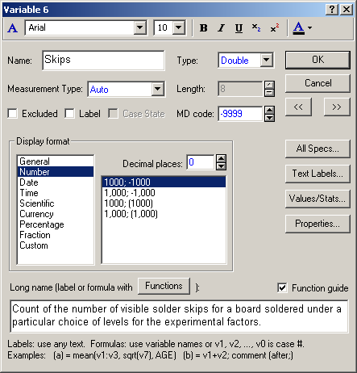
Notes:
Variables
Each variable has a set of properties or specifications associated with it. Click on a variable and select Specs… from the Vars toolbar button menu to display the Variable specification dialog.
Name = variable name, which is displayed in the column header in the spreadsheet.
Type = variable data type.
MD code box is used to specify a missing data code for blank cells or specific values that you intend to ignore in calculations.
Length = specifies the maximum number of characters allowed for the variable (available only if you have selected Text as the data type for the variable).
Under Display format, you can select a format for the variable. When certain display formats are chosen, a box to the right lists additional formats that are compatible with the selected display format.
Decimal places = is used to specify the number of decimal places to be displayed in the spreadsheet (only available when Number, Scientific, Currency, or Percentage is chosen as the display format).
Long name = provide a longer description of the variable, which can optionally be printed out with statistical results, or can be used to define a spreadsheet formula (with help from the Function guide).

Slide 10
Variable Types
Double: ±1.7*10³⁰⁸
Integer: -2,147,483,648 – +2,147,483,647
Byte: 0 – 255
Text: character strings
Notes:
You can specify the data type of each variable in the variable specifications dialog (accessible by selecting Variable Specs from the Data menu). STATISTICA Spreadsheet data files support the four basic data types listed below:
Double is the default format for storing numeric values in STATISTICA. Each numeric value can have a unique text label attached. When your data type is Double, each cell takes up 8 bytes of storage (plus the optional text label).
Integer is the data type to select for whole number values. You cannot enter numeric values containing decimals into a variable of this type. Each numeric value can have a unique text label attached. When your data type is Integer, each cell takes up 4 bytes of storage (plus the optional text label). Hence, this data type offers a more economical way of storing numbers and is recommended for storing integer data in large data files.
Byte is the data type for integers between and including 0 through 255. You cannot enter numeric values containing decimals into a variable of this type. Each byte value can have a unique text label attached. The advantage of specifying Byte as your data type is that it offers the most economical storage for values that are small integers, as each cell takes up only 1 byte of storage (plus the optional text label).
Text is optimized for storing sequences of any characters of long length. The length of a field reserved for text variable type is not constant and can be adjusted.

Slide 11
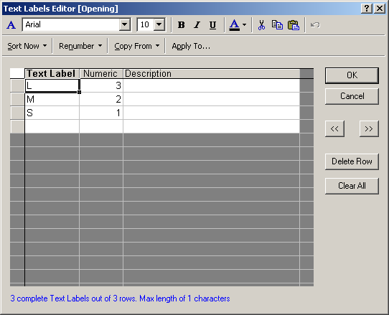
Notes:
Text Labels
For many statistical data analysis applications, it is useful to use text labels that can aid in the interpretation of their respective numeric values. For example, in the input spreadsheet, you could enter the values 3, 2 and 1 in the variable Opening to refer to Large, Medium and Small, respectively. Then, using the Text Labels Editor (accessible by selecting Text Labels Editor from the Data menu), you can assign L to the value of 3, M to the value of 2, and S to the value of 1 . When you click the OK button, all the 3’s in the column of the Opening variable will automatically change to L, all the 2’s will change to M, and all the 1’s will change to S.

Slide 12
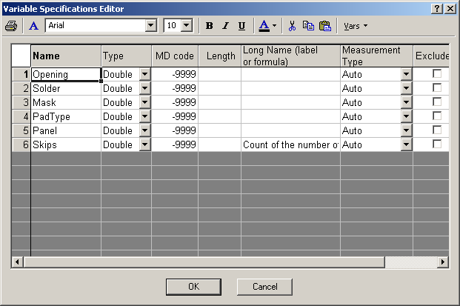
Notes:
Variable Specifications Editor
Specifications for all variables can be reviewed or edited in the Variable Specifications Editor, a spreadsheet-like editor accessible by selecting All Specs from the Vars toolbar button menu.
It is convenient for comparison of or editing specifications of several variables, especially when you need to copy and paste between variables or extend a format definition or missing data code from one variable to subsequent variables.
Right-click on the Variable Specifications Editor to access a shortcut menu containing the following commands: Add Vars, Delete Vars, Cut, Copy, Paste, and Fill/Copy Down.

Slide 13
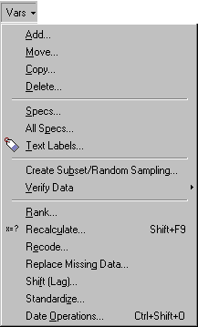
Notes:
Variable Operations
The Vars toolbar button menu contains access to the most common data management operations. Each of the commands on this menu by default operates on the currently selected variable(s) in the STATISTICA spreadsheet.
These operations include simple tasks such as adding, deleting, copying, and moving selected groups of variables in the data file. Other operations include transformations of date values, recalculation of existing spreadsheet formulas, lagging one or more variables against the rest of the data file, converting raw data values into their relative ranks within the variable, recoding a variable using logical selection conditions based on other variables in the data file, and creating a subset of data.
Note: Choose Copy from the Vars toolbar button menu to copy several variables and insert them in another location in the data file. This command produces different results from the Copy command available from the Edit menu, which copies the highlighted block of data to the Clipboard. The former (global) copy performs operations on entire variables (as units); the latter (Clipboard-based) copy only operates on blocks of data within variables. The same logic applies to the Delete command in this menu.

Slide 14
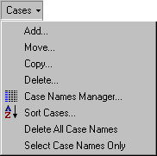
Notes:
Case Operations
The commands on the Cases toolbar button menu are used to perform operations on selected groups of cases in the data file. Again, the Copy and Delete commands here are much different from the commands of the same name on the Edit menu.

Slide 15
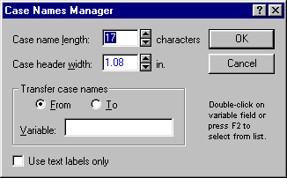
Notes:
Case Names and Case Names Manager
Case names can be used as long, unique identifiers for the observations in the spreadsheet. They are also used by default as labels for many graphs.
To enter case names into the spreadsheet, double-click on the gray header of any case, and type the desired name into the field. Press the Enter key on your keyboard to move to the next case name.
The maximum number of characters in a case name and the case header width can be adjusted in the Case Names Manager dialog, accessible by selecting Case Names Manager from the Cases toolbar button menu.
Also, case names can be transferred from a particular variable to the case name headers in the spreadsheet.

Slide 16
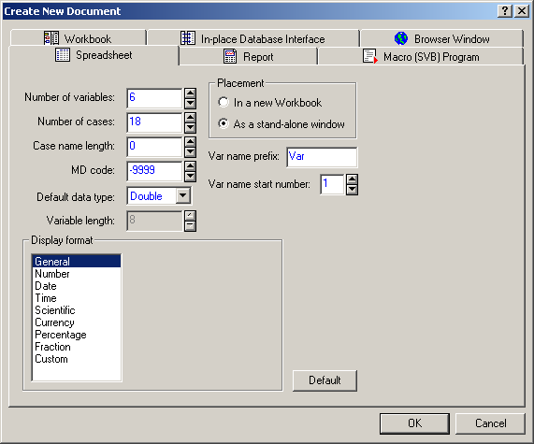
Notes:
Example
Let’s begin by creating a hypothetical data file. We will enter information on 18 parts. The spreadsheet will contain the manufacturer, part type, and the number of occurrences of four types of defects.
1. Create a new data file with 6 variables and 18 cases. To do this, select New from the File menu to display the Create New Document dialog. On the Spreadsheet tab, enter 6 in the Number of variables box and 18 in the Number of cases box. For this example, select the As a stand-alone window option button, and then click the OK button.
2. Save the spreadsheet. Select Save As from the File menu to display a standard Save As dialog, and name this empty spreadsheet “Information.sta”. Click the Save button.

Slide 17
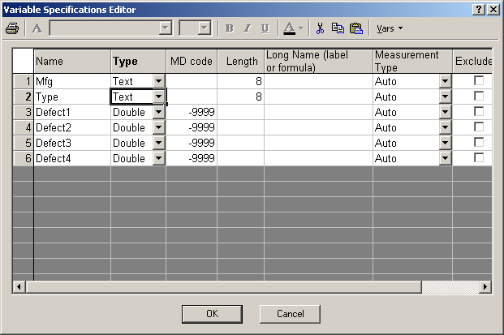
Notes:
Example (cont.)
3. Give the 6 variables the appropriate names as listed above. You can do this several different ways, but the easiest may be to select All Specs from the Vars toolbar button menu to display the Variable Specifications Editor. In the Name column, type in the 6 characteristics. To go from one variable name to the next, use the down arrow key on your keyboard.
4. Change the variable type. Since we know that Manufacturer (Mfg) and part Type will contain only text characters, we may want to change the type of these two variables to Text. You can do this in the Variable Specifications Editor as well. Click the arrow button adjacent to Mfg, and select Text from the drop-down menu; then repeat for Type. Now, click the OK button.

Slide 18
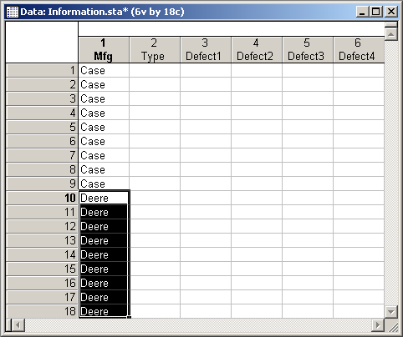
Notes:
Example (cont.)
5. Enter the data. For this example, lets say the first 9 subjects are Case and the last 9 subjects are Deere. You can enter this information easily by using the Fill option. To do this, type Case in the first cell of the variable Mfg. Then select the first 9 rows of this variable including the word Case. Right-click in this highlighted area, and select Fill/Standardize Block - Fill/Copy Down from the shortcut menu. Do the same for the males by entering Deere into the tenth cell, etc.

Slide 19
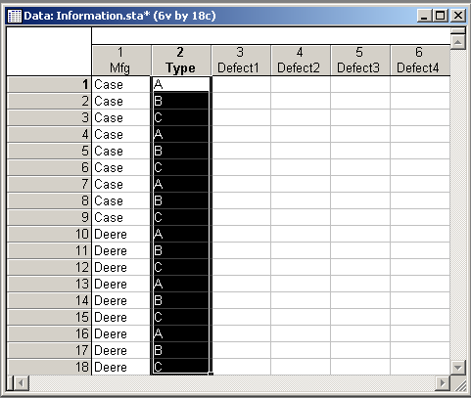
Notes:
Example (cont.)
6. Enter the values for Type. Say we observed three types of parts. Enter A, B, and C into the first three cells under Type. Then, select those three values and use the Excel-style drag-and-drop feature to fill in the remainder of the cells replicating this pattern: Move the cursor to the lower-right corner of the highlighted area until it changes to a black plus (“+”). Then click and drag down the column to the 18th row.

Slide 20
Fill Color
Font Color
Notes:
Example (cont.)
7. Color the cells under Mfg. Specify red for the cells containing Case and green for the cells containing Deere. To do this, select the cells that contain Case, click the arrow on the Fill Color toolbar button, and select red from the color palette. Or you can right-click on the highlighted cells and select Format – Cells from the resulting shortcut menus to display the Format Cells dialog. On the Font tab, click the arrow under Background Color to display a color palette, select white, and click the OK button. Repeat the process for the cells containing Deere, selecting the color green.
8. Color the text in the cells under Type. Specify red for the text in the cells that contain A. To do this, click on one of these cells, and then click the arrow on the Font Color toolbar button. Or you can right-click on a cell and select Format – Cells from the resulting shortcut menus to display the Format Cells dialog. On the Font tab, click the arrow under Text Color to display a color palette, select red, and click the OK button. Repeat the process for the other cells using green for B and blue for C. Alternatively, you can hold down the CTRL key on your keyboard while you click on each cell that contains B, and then apply the green text to all of them at once.
9. Save your changes. Even though we have not yet completed entering the data, save your changes to this data file by selecting Save from the File menu.

Slide 21
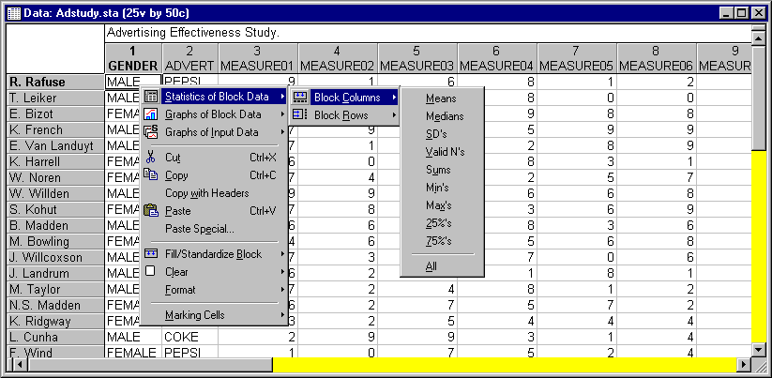
Notes:
Block Stats
Statistics for each row or column in a selected block can be computed and added to the spreadsheet by selecting the desired Statistics of Block Data from the shortcut menu. The selected statistics will be added to the end of the data file as rows or columns.

Slide 22
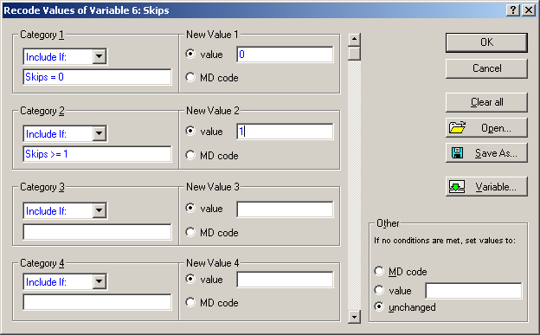
Notes:
Recode
One common data management task is recoding values of a variable. This can easily be accomplished with the Recode facility. Select Recode from the Vars toolbar button menu to display the Recode Values of Variable dialog.
This scrollable dialog is used to define new values of the selected variable depending on the specific conditions that you define. When specifying the conditions, follow the standard syntax conventions. The recoding conditions shown in the illustration would “translate” the 0 values of “Skips” to 0 (no change) and the values greater than or equal to 1 to 1, changing “Skips” from a count variable to a binary variable where 0 = No and 1 = Yes.

Slide 23
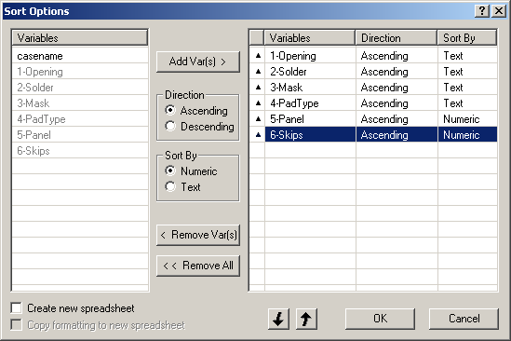
Notes:
Sorting
Select Sort from the Data or Sort Cases from the Cases menu to display the Sort Options dialog.
Sorting can be performed on both text and numeric values, as well as on case names, in either descending or ascending order. STATISTICA will first sort the cases according to Key 1, and then consider Key 2, etc.

Slide 24
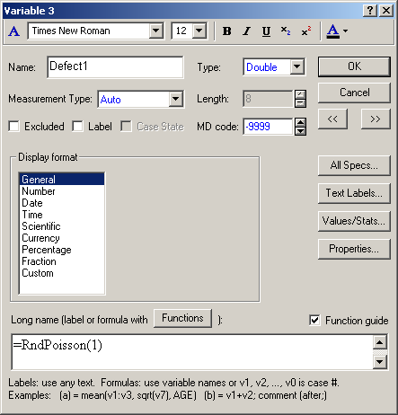
Notes:
Example
1. Open the “Information.sta” data file you created earlier.
2. Create data for Defect1, Defect2, Defect3, and Defect4 by randomly generating data from a Poisson distribution: double-click on each variable’s name in the header for the column and enter the following in the field for “long name”:
“=RndPoisson(1)” for Defect1
“=RndPoisson(2)” for Defect2
“=RndPoisson(3)” for Defect3
“=RndPoisson(4)” for Defect4
When you are finished, click the OK button. A message will be displayed asking if the old values should be recoded to match the new values. Click the Yes button.

Slide 25
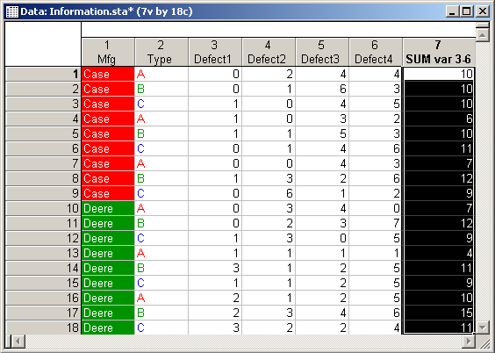
Notes:
Example (cont.)
3. Find the sum of Defect1, Defect2, Defect3 or Defect4 variables for each case. Select all of the values of the cases/values corresponding to Defect1, Defect2, Defect3 or Defect4. Right-click on the highlighted area to display a shortcut menu, and select Statistics of Block Data - Block Rows - Sums.
A variable titled “SUM var 3-6” with the results will be appended to the end of the data file. The values in this variable are static and remain unchanged even if the values in Defect1, Defect2, Defect3 or Defect4 change.

Slide 26
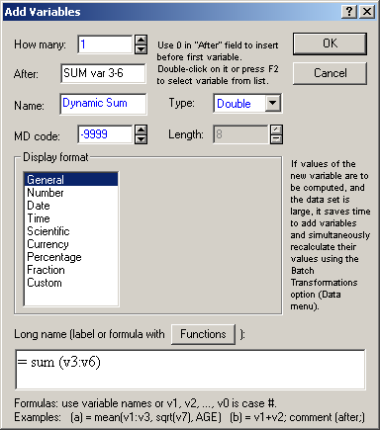
Notes:
Example (cont.)
4. Create a dynamic variable that automatically updates as the data change. First, add a new variable after the “SUM var 3-6” variable. To do this, select Add from the Vars toolbar button menu to display the Add Variables dialog. In the After box, type “SUM var 3-6”, or double-click in the After box to display the Select Variable dialog, and select the variable after which to insert the new one. In the Name box, enter “Dynamic Sum”. Set up a formula in the Long Name box located at the bottom of the Add Variables dialog that will add up the four variables Defect1, Defect2, Defect3, and Defect4. Any of the following formulas would work:
= v3 + v4 + v5 + v6
= ‘Defect1’ + ‘Defect2’ + ‘Defect3’ + ‘Defect4’
= sum (v3:v6)
= sum (‘Defect1’:‘Defect4')
Click the OK button. Change the value for case 1 of Defect4. Notice that the value for “SUM var 3-6” did not change, but the value for “Dynamic Sum” did. If it did not change, select Recalculate from the Vars toolbar button menu to display the Recalculate dialog, and select the Auto-recalculate when the data change option button for Variable 6.

Slide 27
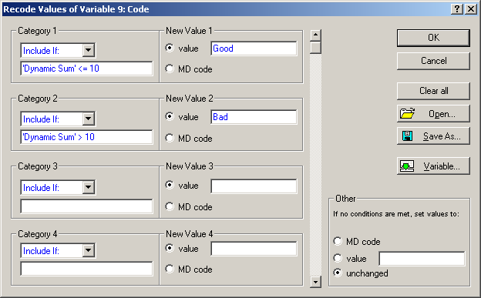
Notes:
Example (cont.)
5. Create another new variable that will contain codes. For example, if Dynamic Sum is less than or equal to 10, then that subject is assigned the code “Good”. If Dynamic Sum is more than 10, then that subject is assigned the code “Bad”. To do this, add a new variable called “Code” to the end of the data file. Now, select Recode from the Vars toolbar button menu to display the Recode Values of Variable dialog. Under Category 1, leave the default Include If in the first box, and enter “‘Dynamic Sum’ <= 10” in the second box. Enter “Good” in the box adjacent to the value option button. In Category 2, leave the default Include If in the first box, and enter “‘Dynamic Sum’ > 10” in the second box. Set the value to be “Bad”. Note that you use the variable name with more than one word, you should use single quotes, such as ‘Dynamic Sum’. Click the OK button.
Note: To view the numeric codes in the spreadsheet, deselect Display Text Labels on the View menu. You can also toggle between displaying/not displaying text labels by clicking the Show/Hide Text Labels toolbar button .

Slide 28
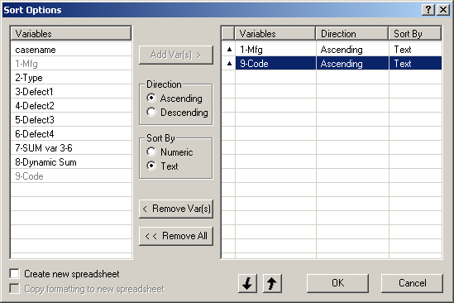
Notes:
Example (cont.)
6. Sort the data file. Arrange the file so that the Case parts are listed first and the Deere are listed second. Within those two groups, sort the cases according to code so that Bad parts are first and and Good parts are second. To do this, select Sort Cases from the Cases toolbar button menu to display the Sort Options dialog. Under the Variables column on the left, select “Mfg”, click Add Var(s), and use the default Ascending order. Repeat for “Code”. Click the OK button.

Slide 29
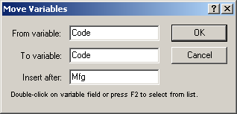
Notes:
Example (cont.)
7. Rearrange the order of the variables. Move the “Code” variable (with its information) to be the second variable in the data file so that you can have a closer look at how it was sorted. Select Move from the Vars toolbar button menu to display the Move Variables dialog. Double click in the boxes on this dialog to display the Select Variable dialog, where you can select the variable you want to move. Insert the variable Code after “Mfg”. (The From variable and To variable options are helpful when you want to move a range of variables at once.)

Slide 30
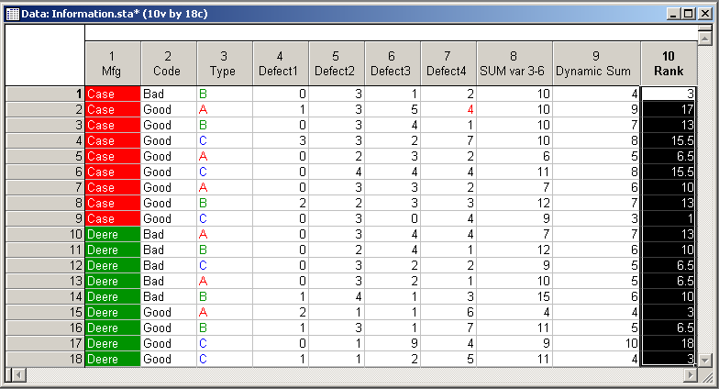
Notes:
Example (cont.)
8. Rank variables. Rank the subjects by ”Dynamic Sum” with the smallest value receiving the lowest rank. First, add a new variable called “Rank” after the variable “Dynamic Sum”. Next, copy the values from “Dynamic Sum” to the Clipboard and paste them into the variable “Rank”. Select “Rank” from the Vars toolbar button menu to display the Rank Order Values dialog. Click the Variables button and select “Rank”. Under Assign rank 1 to select the smallest value option button (smallest “Dynamic Sum”). Keep everything else at default and click the OK button. Now you can compare the ranks to the raw data values that still reside in the “Dynamic Sum” variable. The smallest value of “Dynamic Sum” is “3” and it receives a rank of “1” (based on the values shown above).
9. Save changes. Select Save from the File menu.

Slide 31
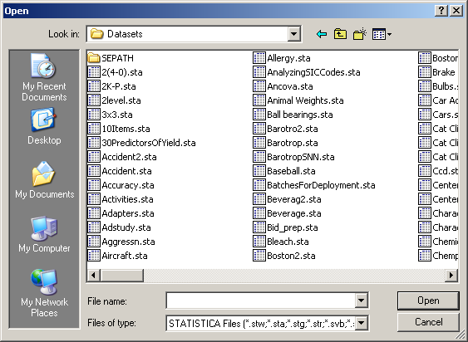
Notes:
Importing Data
The quickest, and in many cases easiest, way to access data files from other Windows applications is to use the Clipboard facility. STATISTICA supports special Clipboard data formats generated by applications such as Microsoft Excel. For example, STATISTICA properly interprets formatted cells (such as 4/17/1999 or $10) and text values, including extensive in-cell formatting.
Data files from a wide variety of Windows and non-Windows applications can also be accessed and translated into the STATISTICA format (.sta) using the file import facilities. Importing begins with selecting Open from the File menu.

Slide 32
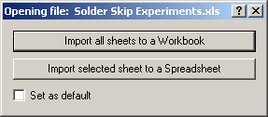
Notes:
Importing Data (cont.)
A variety of files is available from the Files of type drop-down list (STATISTICA documents, Excel, dBASE, SPSS Portable, Lotus/Quattro Worksheets, Text, HTML, and Rich Text Files). After selecting the file to be opened in STATISTICA, you can specify the exact way in which the translation is to be performed. For instance, when you select an Excel file to be opened, you are prompted to select if STATISTICA should Import all sheets to a Workbook or Import selected sheet to a Spreadsheet.

Slide 33
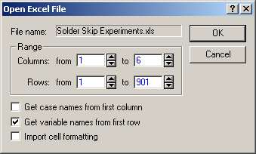
Notes:
Importing Data (cont.)
Next, you can specify the ranges in the foreign data file to be imported and decide whether to import case and variable names.
This ability to specify the exact way in which a file is to be imported is a distinct advantage of using the file import facilities instead of the Clipboard. In addition, you can access types of data that are not (or not easily) accessible to Clipboard operations.

Slide 34
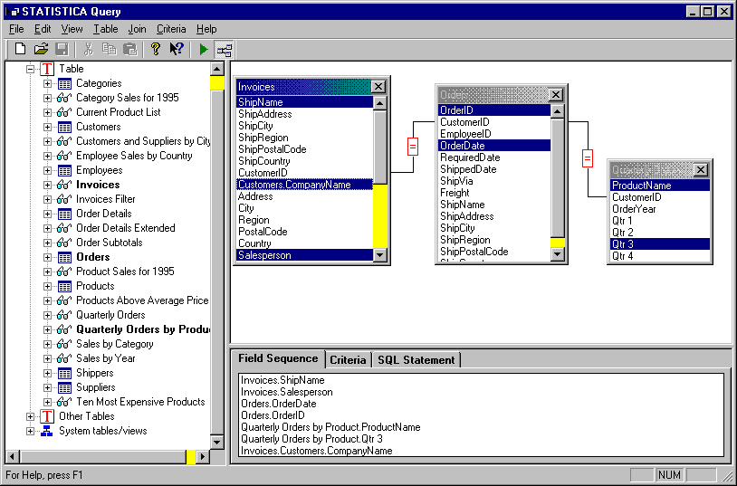
Notes:
Statistica Query
In addition to the file import facilities described above, STATISTICA provides access to most databases (including many large system databases such as Oracle, Sybase, etc.) via STATISTICA Query, accessible from the File – Get External Data menu.
STATISTICA Query supports multiple database tables where specific records (rows of tables) can be selected by entering SQL statements. STATISTICA Query automatically builds the SQL statement for you as you select the components of the query via a simple graphical interface and/or intuitive menu options and dialogs. Multiple queries based on one or many different databases can also be created to return data to an individual spreadsheet, so you can maintain connections to multiple external databases simultaneously.

Slide 35
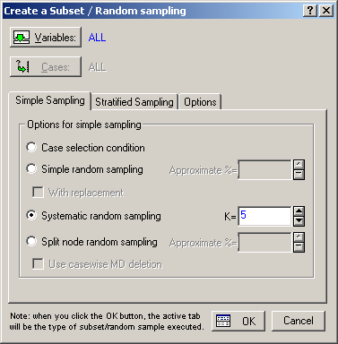
Notes:
Random Subset
STATISTICA includes a facility that allows the user to randomly sample any dataset in order to create a subset dataset for analysis. To do this, select Subset/Random Sampling from the Data menu. Subsets of data can be created via both simple random sampling and systematic random sampling.
To perform simple random sampling, you have two choices with regard to how the subset is created: either by a percentage of the original spreadsheet or by an approximate number of cases. Also, you can choose to sample with replacement, and choose to use previously selected spreadsheet case weights.
With systematic random sampling, your subset is collected from every kth case in the dataset. For example, if you enter a 5 in the K= box, STATISTICA will randomly select a case within the first five cases and then finish obtaining the subset by selecting each fifth case in the spreadsheet after the originally selected case.

Slide 36
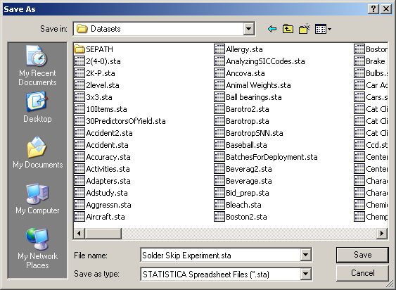
Notes:
Exporting Data
STATISTICA can export data files to numerous Windows and non-Windows applications using the file export facilities. To export, select Save As from the File menu to display the Save As dialog.

Slide 37
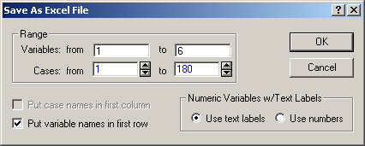
Notes:
Exporting Data (cont.)
A wide variety of files is available in the Save as type drop-down list (STATISTICA spreadsheet, STATISTICA Matrix, Excel, dBASE, SPSS Portable, Lotus Worksheets, Quattro Pro/DOS, Text, HTML, and STATISTICA 5 spreadsheet). After you select the type of file to save the spreadsheet as, you can specify the exact way in which the translation is to be performed. For instance, if you save it as an Excel workbook, you are prompted to decide the range of the data file and whether to export variable names, case names, and text labels.

Slide 38
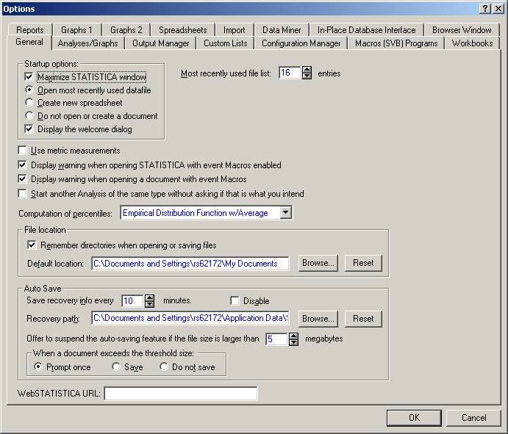
Notes:
Options: From the Tools menu, you can access the Options dialog, which contains 12 tabs. In addition to general and display options, these tabs contain options for reports, file locations, custom lists, workbooks, macros, statistical analysis display, import and edit facilities, and output management.
The General tab contains options to modify STATISTICA’s defaults: appearance of STATISTICA upon startup, warnings, computation of percentiles, file location, and auto save features.
Analysis/Graphs tab contains general analysis and graph display options.
Output Manager tab contains various options to route output to individual windows, workbooks, and reports.
Custom Lists tab contains options to define a custom list for auto-extrapolation in a spreadsheet.
Configuration Manager tab contains options to create, manage, and modify separate configurations of STATISTICA.
Macros tab contains options to edit fonts, color scheme, and warnings of SVB scripts.
Use the Workbooks tab to specify display proportions, tab control, and other default workbook options.
Reports tab contains options to modify printing, exporting, and sizing of objects placed in a report.
Graphs 1 tab contains options to adjust point markers, lines, and colors of graphs.
Graphs 2 tab contains options to customize plot layouts.
Use the Spreadsheet tab to control various options for navigating and editing a spreadsheet.
Import tab contains options for Excel, Text, and HTML importing.

